Slide 1

FAITH & DISCIPLINE IN THE BUSINESS
PURUSHOTTAM & PUSHPA
{DUCD}
WINNERS ALWAYS FIND THE WAY TO WIN !
Notes:
PURUSHOTTAM KUMAR (DUCD )

Slide 2
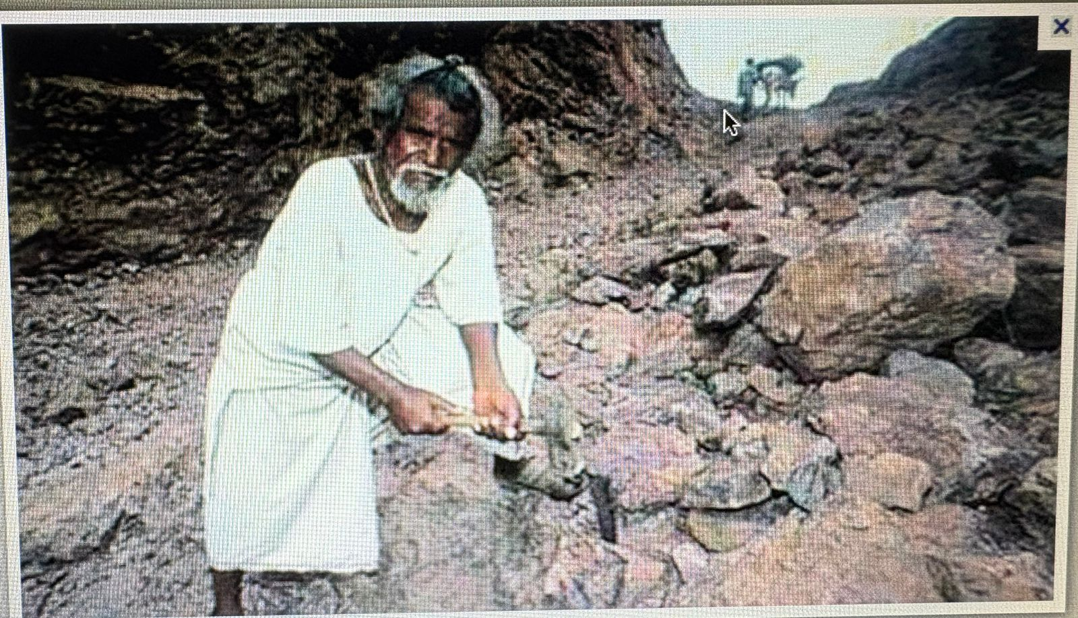

PICTURE OF MOUNTAIN IN BIHAR ( GAYA JI )

Slide 3
FAITH HONA CHAHIYE
1. SELF
GOD /ALLAHA……ETC
WINNING TEAM
VESTIGE
SELF DREAM

Slide 4
DREAM / NEXT 3 TO 5 YEARS PLAN …..
DO YOU KNOW ?????
GOD HAS MAKE A PLAN FOR EVERYONE
BUT
MERA PLAN KAYA HAI ( SOCHA HI NAHI )
{ STORY OF MYSELF }
STARTED JOURNEY OF DIRECT SELLING FROM 2002
******** TIME *RATE/ENERGY KO MULTIPLY KARO *****

Slide 5
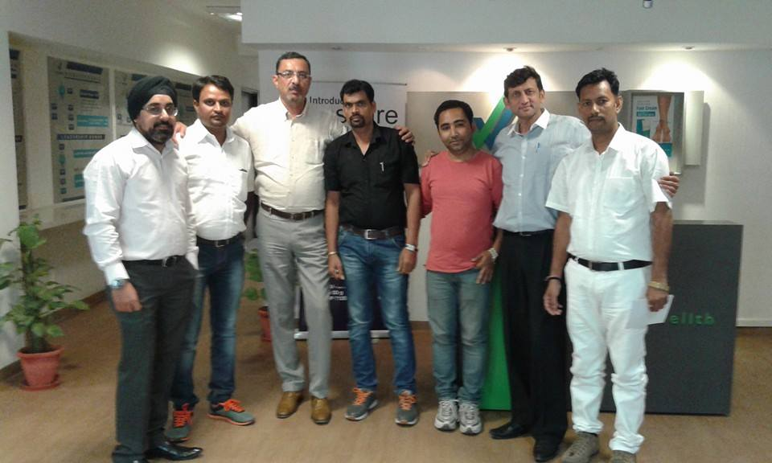
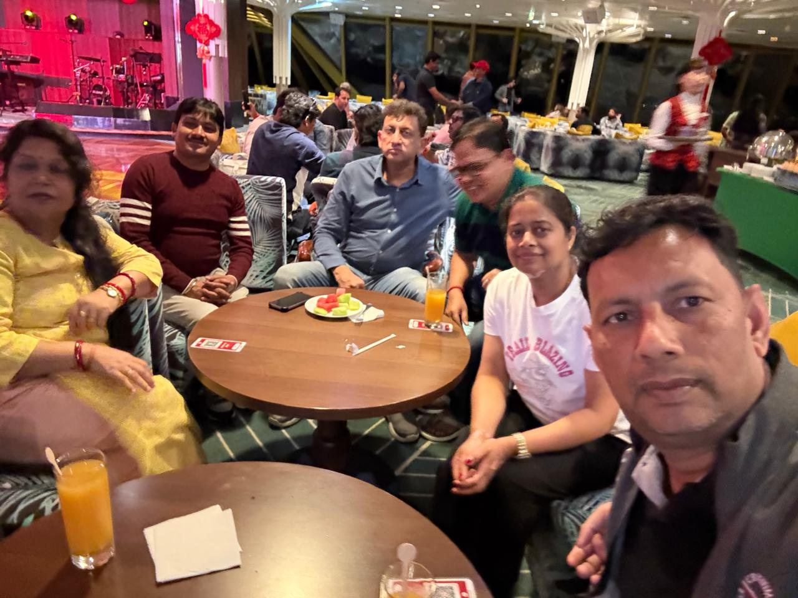
WHEN I START THE BUSINESS
STORY OF KING AND THERE MINISTER
FEB -2015
FEB-2025
AFTER 10 YEARS

Slide 6



LIFE NAHI LIFESTYLE HAI YARAA BUS AAPKO FAITH KARNA PADEGA

Slide 7
EXAMPLE:
WHEN A CHILD SWIMMING .
DOCTER & PATIENT

Slide 8

YOU HAVE 100% FAITH BUT YOU HAVE NO DISCIPLINE IN THE BUSINESS YOU CAN’T SUCCESS

Slide 9

SUCCESS FORMULA
**50 % …… DISCIPLINE
25% ……CONSISTENCY
15%......MINDSET
5% …….HARD WORK
5%......SMART WORK

Slide 10
IN MY BUSINESS SOME DISCIPLINE
10 CORE STEP
RESPECT FOR UPLINE
CNC & PAC
ATTEND ALL FUNCTION OF WINNING TEAM / VESTIGE
ALWAYS GOOD ASSOCIATION
HOME MEETING / ONE TO ONE MEETING

Slide 11
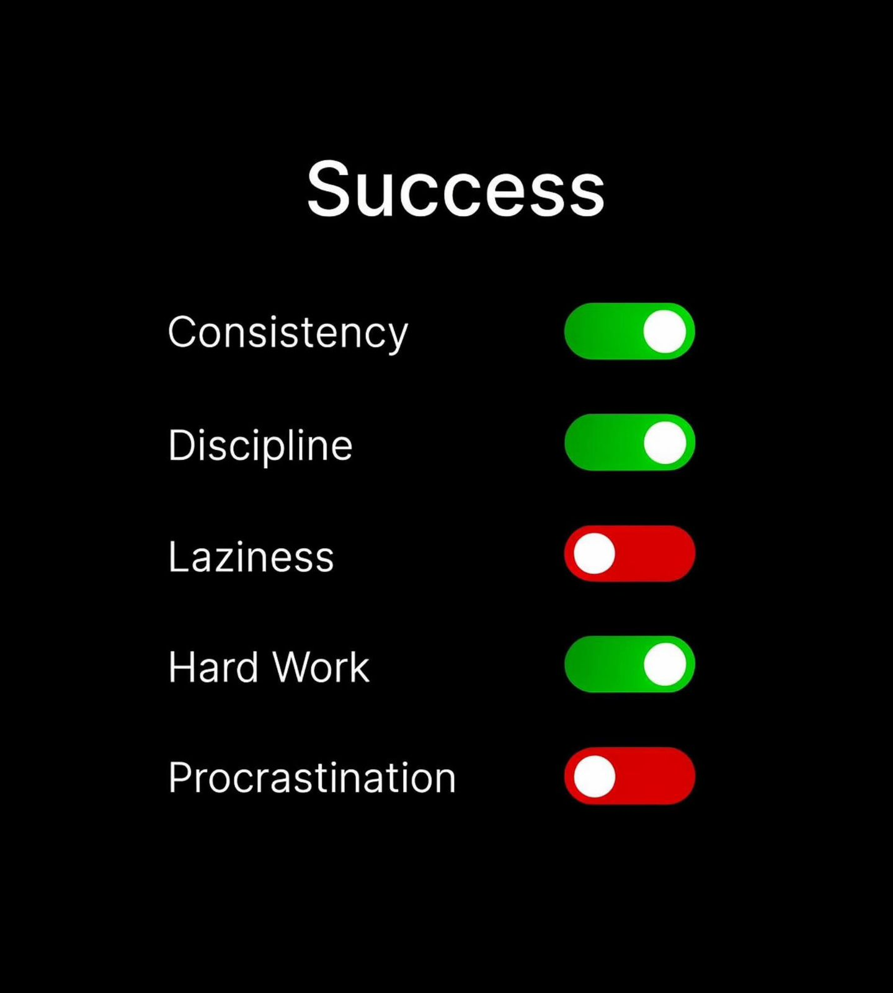
BIG GOALS REQUIRE BIG DISCIPLINE
SUCCESS DEMAND

